Slide 1


Department of real estate forum
Sacramento Convention Center
Sacramento
May 3, 2019

Slide 2

Today’s Agenda
  Opening Remarks –
  Acting Commissioner Dan Sandri
    Operations & Licensing Report –
    Sandra Knau, Assistant Commissioner, Administration
    Enforcement Report –
    Jeff Oboyski, Assistant Commissioner, Enforcement
    Audit Report –
    Tom Cameron, Assistant Commissioner, Audits
    Subdivision Report –
    Chris Neri, Assistant Commissioner, Subdivision
    Legal, Legislation and Consumer Recovery Account Report –
    Stephen Lerner, Assistant Commissioner, Legal Affairs
    Q & A and Dialogue
    Dan Sandri and Panel

Slide 3
Department
of Real Estate
Operations report
Sandra Knau
Assistant Commissioner Administration & Licensing

Slide 4
DRE Operations
Five District/Exam Offices
    Fresno
    Los Angeles
    Oakland
    Sacramento
    San Diego
  Authorized Positions: 354

Slide 5
Financial Statistics
July 1 to March 2019 Revenues -$36,258,784
DRE FY 18/19 Budget 52.9 million

Slide 6
Financial Statistics
July 1 to March 2019 Expenditures -$35,189,209
DRE FY 18/19 Budget 52.9 million

Slide 8
Information Technology
What’s Completed
Subdivision Online Public Report Application System (SOPRAS) implemented September 2018
Broker-Associates on eLicensing- implemented on October 2018
New Virtual Call Center (VCC) System-implemented December 2018

Slide 9

Information Technology
What’s New-
Corporate Broker-Officer renewals added to eLicensing

Slide 10
Corporate Broker-Officer Renewals added to eLicensing
Broker-officers may now use eLicensing to renew corporate broker-officer license
Corporation and broker-officer license must be in a “licensed” status to be able to renew on eLicensing
A broker-officer license must be renewed within 90 days of the expiration date of the broker-officer license to use eLicensing

Slide 11
Corporate Broker Officer Renewals added to eLicensing
If broker-officer has a current individual broker license, no continuing education necessary to renew officer license
If broker-officer holds an officer only license, continuing education completed within the last 4 years must be entered into eLicensing

Slide 12
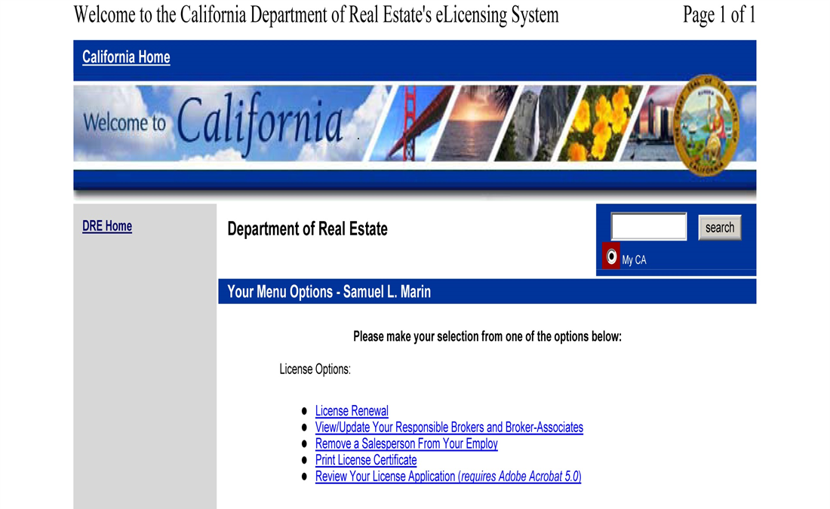
Broker-Officer license menu screen

Slide 13
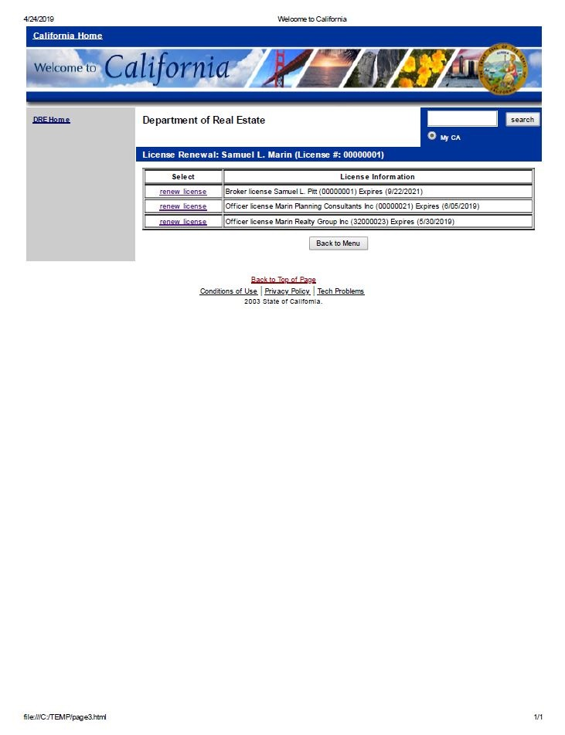
Broker-Officer renewal menu screen

Slide 14
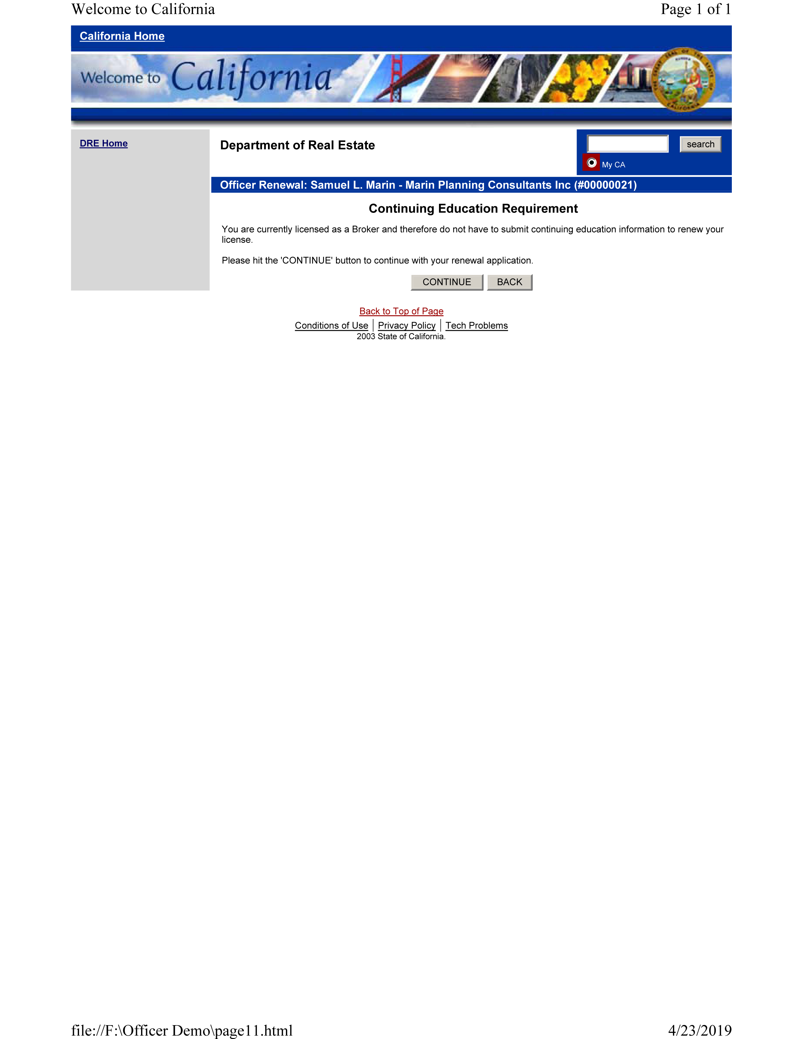
Broker-Officer renewal
No Continuing Education Needed

Slide 15
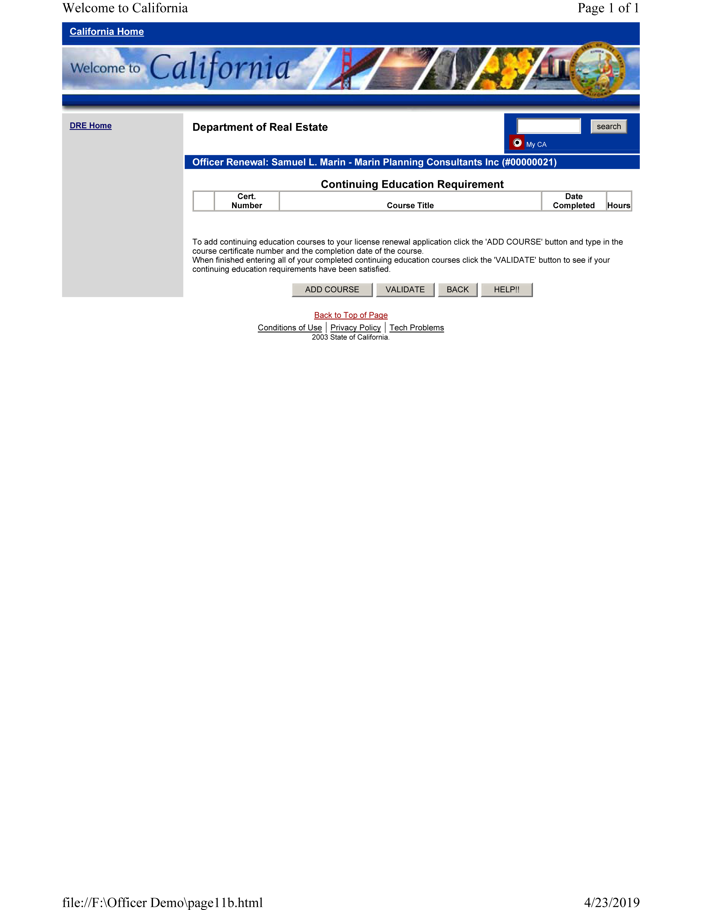
Broker-Officer renewal
Continuing Education Needed

Slide 16
Information Technology What’s Next-
Website redesign- June 2019
Online submittal of exam and license applications-tentative date of July 2019
Second phase of SOPRAS- tentative date December 2019

Slide 17
Department of Real Estate
Administration & Licensing
Contact:
Sandra Knau
Assistant Commissioner-Administration & Licensing
Phone: (916) 576-8776

Slide 18

Enforcement
Jeff Oboyski
Assistant Commissioner-Enforcement

Slide 19

Jeff’s DRE Program Experience
Enforcement
Legislation
Licensing

Slide 20

Evolution of Real Estate
Usage of “Team Names” and “Mega Teams”.
Virtual Real Estate Brokerages.
On-line companies that offer quick-sale services; offer to purchase homes using computer algorithms; and send cash offers to motivated sellers within just a couple of days.

Slide 21
Broker Supervision
Business & Professions Code section 10015.1 provides, “‘Responsible broker’ means the real estate broker responsible for the exercise of control and supervision of real estate salespersons under Section 10159.2, or a licensee subject to discipline under subdivision (h) of Section 10177 for failure to supervise activity requiring a real estate license.”
Business & Professions Code section 10159.2(a) states, “The officer designated by a corporate broker licensee pursuant to Section 10211 shall be responsible for the supervision and control of the activities conducted on behalf of the corporation by its officers and employees as necessary to secure full compliance with the provisions of this division, including the supervision of salespersons licensed to the corporation in the performance of acts for which a real estate license is required.”

Slide 22
Broker Supervision (cont.)
Business & Professions Code section 10177(h) states, “As a broker licensee, failed to exercise reasonable supervision over the activities of his or her salespersons, or, as the officer designated by a corporate broker licensee, failed to exercise reasonable supervision and control of the activities of the corporation for which a real estate license is required.”
Commissioner's Regulation section 2725 provides, in part, “A broker shall exercise reasonable supervision over the activities of his or her salespersons.”
This regulation requires that the broker have policies, procedures, and systems in place to review, oversee, and manage the activities of his or her salespersons.

Slide 23
Broker Supervision (cont.)
Business & Profession Code section 10162 provides “Every licensed real estate broker shall have and maintain a definite place of business in the State of California that serves as his or her office for the transaction of business. This office shall be the place where his or her license is displayed and where personal consultations with clients are held.”
Recently published article in the Spring 2019, Real Estate Bulletin titled, “Technology and Supervision in the Real Estate Industry.

Slide 24
Current Consumer Protection Issues
Criminal activity involving wire transfers and electronic fund transfers (EFTs) in real estate purchase transactions.
Criminals interject themselves by posing as a party in the transaction (i.e., a title or escrow company or even a real estate agent).
What consumers should do to avoid being a victim to such scams.
1. Whenever possible, use alternatives to wire transfers or EFTs, such as cashier’s checks, and get a receipt.

Slide 25
Current Consumer Protection Issues (Cont.)
2. Obtain and confirm phone numbers and account numbers of real estate agents and escrow-holders at beginning of the transaction, and use those numbers throughout the transaction.
3. Do not act on a change of wiring or EFT instructions that you receive electronically (via email) or via call without first calling your real estate agent or escrow officer.
4. Do not send personal information (bank account numbers, credit card numbers, social security numbers, and financial details) by personal email or text.

Slide 26
Current Consumer Protection Issues (Cont.)
DRE has received complaints from licensees purporting that their public license information, including license identification numbers, have been used for fraudulent activities.
Business & Professions Code section 10083.2(a)(1) provides, “The commissioner shall provide on the Internet information regarding the status of every license issued by the department in accordance with the California Public Records Act (Chapter 3.5 (commencing with Section 6250) of Division 7 of Title 1 of the Government Code) and the Information Practices Act of 1977 (Chapter 1 (commencing with Section 1798) of Title 1.8 of Part 4 of Division 3 of the Civil Code).”
If you believe your public license information is being used for fraudulent purposes, please contact the Department’s Enforcement section so that we can look into it.

Slide 27

Emphasis on Field Investigations
Special Investigators currently have caseloads of between 40-45 cases.
Emphasis on field work.
Expectation that Special Investigators perform proactive broker office surveys.

Slide 28
Enforcement Program -Outreach
In an effort to increase DRE’s presence and involvement with California’s real estate industry, District Office Managers (Sacramento, Oakland, Fresno, Los Angeles and San Diego) have contacted the local boards and associations in their respective jurisdictions in an attempt to introduce themselves, and to offer to meet and speak to their members.
DRE has received positive feedback from industry as a result of this outreach initiative!

Slide 29
Department of Real Estate
Enforcement Section
Jeff Oboyski – Assistant Commissioner, Enforcement
Jeff.Oboyski@dre.ca.gov
(916) 576-8851

Slide 30

Audit Report
Tom Cameron
Assistant Commissioner, Audits

Slide 31
Audits Closed by Activities Statewide 7/1/18 – 3/31/19

Slide 32
Findings of Audits Closed
7/1/18 – 3/31/19

Slide 33
Shortage Findings of Audits Closed
7/1/18 – 3/31/19
Total audits closed – 374
$5.7 Million
31.2% had shortages
68 audits > $10,000 short,11.2%

Slide 34
Commissioner’s Regulation 2831.2
“The balance of all separate beneficiary or transaction records maintained pursuant to the provisions of Section 2831.1 must be reconciled with the record of all trust funds received and disbursed required by Section 2831, at least once a month, except in those months when the bank account did not have any activities. A record of the reconciliation must be maintained.”

Slide 35
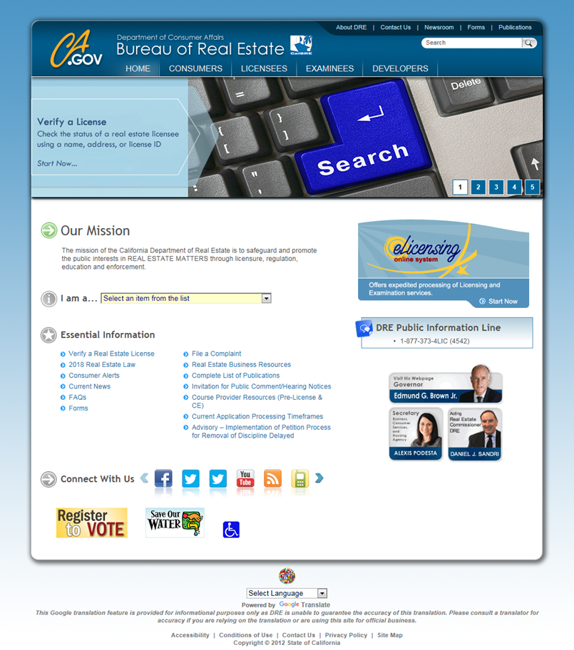
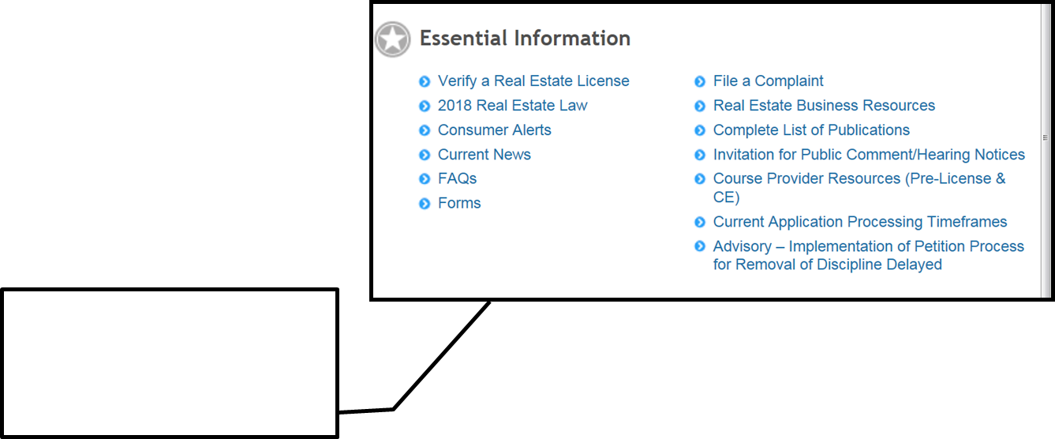
Trust Account Reconciliations

Slide 36
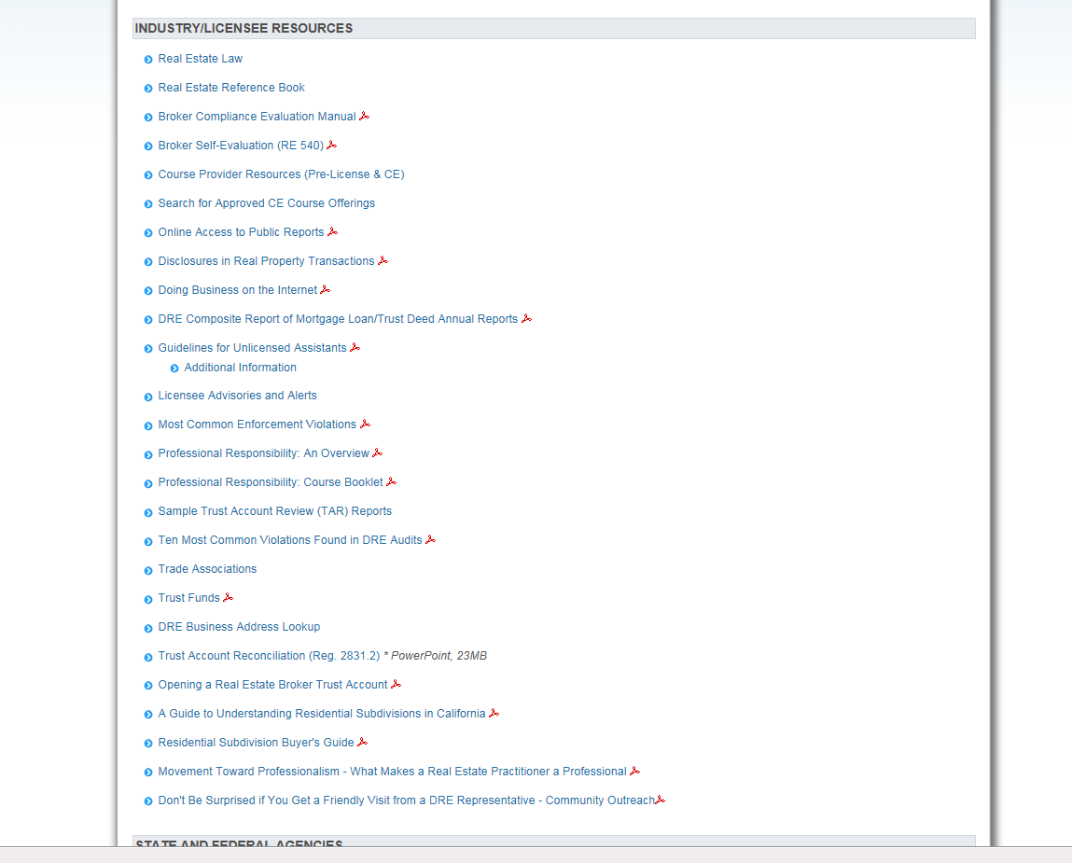
Real Estate Business Resources

Slide 37
Audit Case
Complaint from Enforcement
Auditor scheduled the audit
Four bank accounts were reconciled
Shortages in excess of $188,000
Personal properties with negative balances
Transfers to business account for personal use - $18,000

Slide 38
Audit Case
Bank accounts not designated
Unlicensed/unbonded signers
Not reconciling
REB surrendered license

Slide 39
Department of Real Estate
Audit Section
Tom Cameron – Assistant Commissioner, Audits
Tom.Cameron@dre.ca.gov
(916) 576-8777

Slide 40
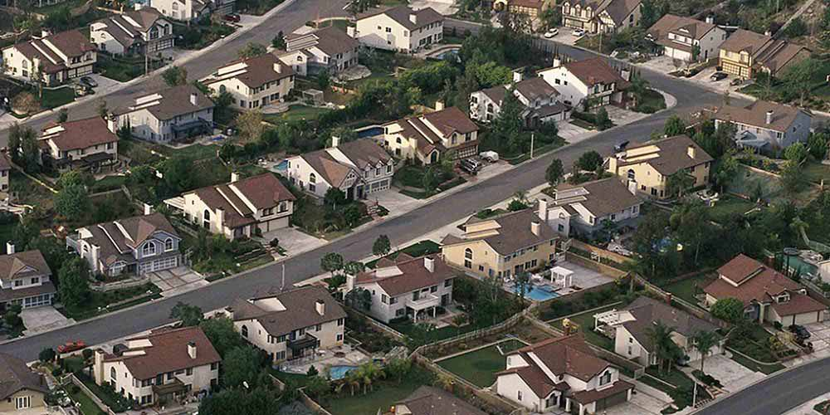
Subdivisions Report
Chris Neri, Assistant Commissioner- Subdivisions

Slide 41
Subdivision Filings
(July 1 – March 31)
 | FY 17/18 | FY 18/19 | % Change
Final Public Reports | 2,460 | 2,389 | -2.88%
Number of Lots/Units for Issued Final Public Reports | 30,293 | 30,409 | 0.38%

Slide 42
Final Public Report Filings by FY
(July 1-March 31)

Slide 43
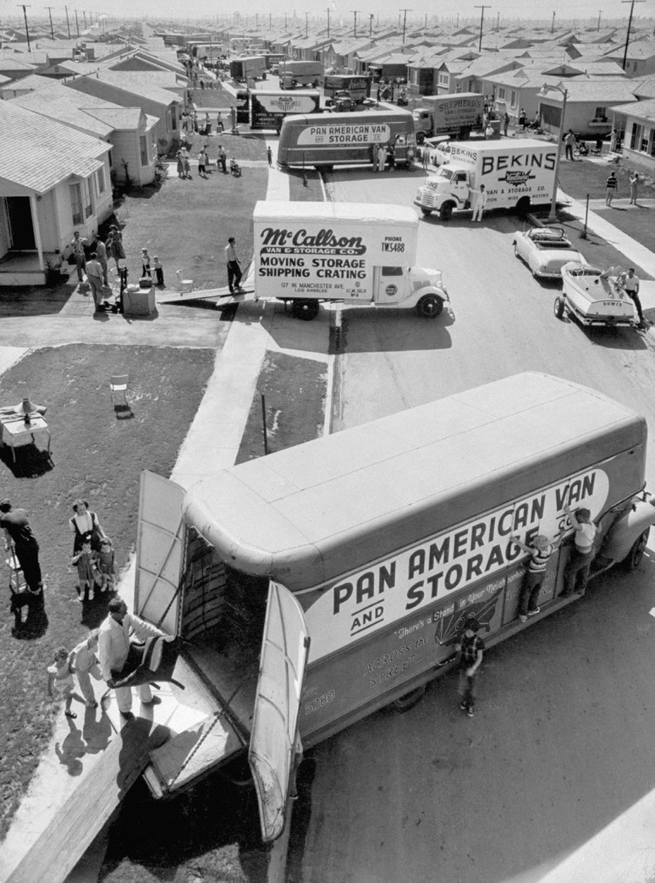
Types of Subdivisions
Standard
Common Interest
  Condominium
  Planned Development
  Stock Cooperative
  Community Apartment
Undivided Interests
  Tenancy-in-Common (TIC’s)

Slide 44
Issued Public Reports by Subdivision Type
(July 1 – March 31)

Slide 45
Types of Public Reports
Preliminary Subdivision Public Reports - (PINK) typical term of 1 year
Conditional Subdivision Public Reports - (YELLOW) typical term of 6 or 30 months depending on the project type
Final Subdivision Public reports - (WHITE) typical term of 5 years
All of these reports can be amended or renewed, as needed.

Slide 46
Notable Development Trends
Local Government Requirements
  HOA maintenance of public amenities
  Transit passes
  HOA assessment subsidization (Market vs. Affordable)
Sale of Recreational Facility to HOA
Higher density housing

Slide 47
What Do You Need To Know
What constitutes a “subdivision”
Common interest governing documents
The “Public Report”
Use of the accepted purchase contract
Use caution with “oral representations”
Civil Code Section 4525
Solar Arrangements

Slide 48
Resale Transactions
Davis-Stirling - Civil Code 4525
The following information must be provided by the owner to the prospective buyer before transfer of title:
Governing documents (CC&R’s, Bylaws and Articles)
Age restricted property statement, if applicable
Financial statements
HOA assessment and delinquency statement

Slide 49
Resale Transactions
Davis-Stirling - Civil Code 4525
Notice of violation of the governing documents
Construction defect information
Any change in the HOA’s current assessment structure
Rental restrictions, if applicable

Slide 50
Where to Find More Information
www.dre.ca.gov/Developers/
The following publications may be of assistance:
  Real Estate Law & Reference Books
  Residential Subdivision Buyer’s Guide
  Guide to Understanding Residential Subdivisions in California
  Living in a Common Interest Development
  Subdivision Public Report Application Guide (SPRAG)

Slide 51
Department of Real Estate
Subdivisions
Contact:
Chris Neri
Assistant Commissioner - Subdivisions
Phone: (916) 576-8854

Slide 52
Legal affairs
Stephen Lerner
Assistant Commissioner
Legal Affairs

Slide 53
Legal affairs
● Administrative
Prosecutions
● Consumer
recovery account
● Statutes
● Regulations

Slide 54
Legal Affairs
● Offices
● Los Angeles
● Sacramento
● Operational Units
● Los Angeles Administrative Prosecution Unit
● Sacramento Administrative Prosecution Unit
● Consumer Recovery Account
● Special Projects/General Law

Slide 55

Legal Affairs
Disciplinary Tools
Revocation
Restriction
Suspension
Surrender
Public Reproval
Corrective Action Letter
Cite and Fine
Desist and Refrain Order
Bar Order

Slide 56
Legal Affairs
Disposition of Cases
Category | July 1, 2018 – March 31, 2019
Desist & Refrain Orders | 17
License Suspensions | 74
License Surrenders | 52
License Revocations | 284
Case Dismissals | 29
Public Reprovals | 2
Stipulations & Waivers/Agreements | 160
Application Denials | 107
License Denials and Restrictions | 63
Bar Orders | 3
Total | 791

Slide 57
Consumer Recovery Account

Slide 58
Consumer Recovery Account
(July 1, 2018 – March 31, 2019)
Category |  | Total
Claims Filed |  | 141
Disposition of Claims | Paid | 53
 | Denied | 24
Amount Paid |  | $2,473,434

Slide 59
Consumer Recovery Account
Claims Filed & Total Amount Paid
(Fiscal Year)
Claims Filed
FY 13/14 | 153
FY 14/15 | 154
FY 15/16 | 74
FY 16/17 | 52
FY 17/18 | 66
7/1/18 - 3/3/1/19 | 141

Slide 60
Consumer Recovery Account
Claims Filed & Total Amount Paid
(Fiscal Year)
Total Amount Paid
FY 13/14 | $4,286,536 (104 claims paid)
FY 14/15 | $4,898,912 (119 claims paid)
FY 15/16 | $3,396,293 (81 claims paid)
FY 16/17 | $1,434,411 (73 claims paid)
FY 17/18 | $1,424,559 (39 claims paid)
7/1/18 – 3/31/19 | $2,473,434 (53 claims paid)

Slide 61
CONSUMER RECOVERY ACCOUNT
Claims History
Since 1964, DRE has paid
over $65 million to victims
of real estate fraud

Slide 62
Update: 2018 Legislation

Slide 63
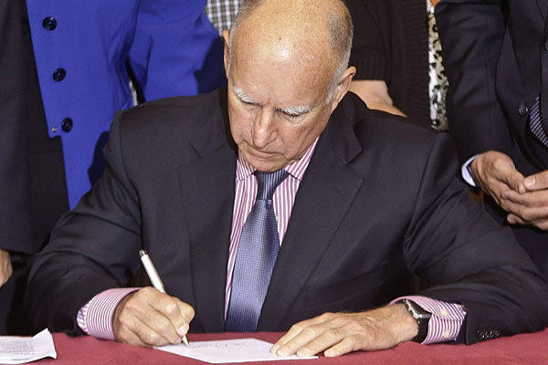
Overview of 2018
Legislative Activity
Bills that reached
the Governor’s Desk: 1,217
Bills Signed: 1,016
Bills Vetoed: 201

Slide 64
Overview of 2018
Legislative Activity
Signed by Governor
● AB 1289 (Arambula)
● AB 2138 (Chiu and Low)
● AB 2884 (Irwin)
● SB 721 (Hill)

Slide 65
AB 2884 (Irwin)
AB 1289 (Arambula)
Both bills include a “Savings Clause” added to statute to preserve existing legal duties and relationships
The bills move real estate definitions from the Civil Code to the Real Estate Law
Licensees must report a felony criminal complaint filed against them to the DRE, just as with an indictment currently
Brokers are no longer required to keep the paper licenses for themselves and their salespersons
AB 1289 amends Civil Code Sections 2079.16 and 2079.21 to expand the information a dual agent may withhold from clients

Slide 66
AB 2138 (Chiu and Low)
Existing law:
● Authorizes denial of license if applicant is convicted of felony or substantially-related misdemeanor
● Authorizes denial of license if applicant knowingly made a false statement of fact that is required to be disclosed on his/her application
● Precludes denial of a license solely based on a conviction if conviction dismissed or expunged

Slide 67
AB 2138 (Chiu and Low)
New law:
● Precludes denial of license if applicant convicted of a crime that is more than 7 years old
◦ Exception: Convictions for serious felonies or financial crimes
● Precludes denial of license based on acts underlying a conviction if conviction has been dismissed or expunged
● Precludes entity from inquiring about criminal history on license applications
● Effective July 1, 2020

Slide 68
SB 721 (Hill)
● Inspection of decks or balconies for buildings with 3+ dwelling units
◦ Performed by licensed architect, engineer or specified building contractor
● Inspections to be conducted
◦ Initially by January 1, 2025
◦ Subsequently every 6 years
● Repairs to be completed within 120 days
● Inspection report submitted to DRE for condo conversions
◦ Condition to issuance of final public report

Slide 69
Regulations
● First Point of Contact
● Removal of Discipline from DRE’s Website

Slide 70
First Point of Contact
● AB 1650 (Frazer)
● Regulations under development
  ◦ Effective Date: March 28, 2019
● Proposed Regulations
  ◦ License number required on “1st Point of Contact” solicitation materials
  ◦ Responsible broker’s number not required as long as responsible broker’s name/logo appears with name and license number of salesperson or broker associate

Slide 71
First Point of Contact (Continued)
● 1st Point of Contact
  ◦ Business Cards
  ◦ Stationery
  ◦ Websites owned or controlled by the soliciting licensee
  ◦ Promotional and advertising flyers, brochures, leaflets, etc.
  ◦ Advertisements in electronic media (internet, e-mail, radio, television, etc.)
  ◦ Print advertising in any newspaper or periodical
● Excludes “for sale”, “for rent” or “open house” sign where sign has no name/logo or the name/logo belongs to the responsible broker

Slide 72
Petitions to Remove
Discipline from Website
AB 2330 (Ridley-Thomas)
  ● Prior law required DRE to post status of every license on its website
    ◦ Including all discipline
  ● New law authorizes the Commissioner to set up a petition process to remove discipline from the website
    ◦ Licensees only (not available to unlicensed or non- licensed)
    ◦ Discipline must be 10 years or older
    ◦ Petitioner must pay a fee set by regulation
    ◦ Findings that no credible risk to members of the public
    exists as a condition to removing discipline
  ● Effective Date: March 7, 2019

Slide 73
Advertising:
DBA v. Team Names

Slide 74


Example 1
Example 2

Slide 75


Example 3
Example 4

Slide 76

Example 5

Slide 77
DBA’s
Bus. & Prof. Code section 10159.7(a)(1):
  “‘Fictitious business name’ means a professional identity or brand name under which activity requiring a real estate license is conducted . . . .”

Slide 78
DBA’s
2 Classifications of DBA’s:
● Broker-owned fictitious business name
● Salesperson-owned fictitious business name
  Contract with responsible broker authorizing salesperson to file/obtain a fictitious business name (Bus. & Prof. Code §10159.5(a)(2))
  Use of the name as permitted by the responsible broker (Bus. & Prof. Code §10159.5(b)(1))
  Broker still responsible for supervising salespersons ((Bus. & Prof. Code §10159.5(b)(2))

Slide 79
DBA’s
Steps to obtain a fictitious business name:
If salesperson, contract with broker for authority to file/obtain a fictitious business name
Obtain a fictitious business name from the county clerk
Deliver a fictitious business name application to DRE
  Signed by the responsible broker

Slide 80
DBA’s
Reasons why a DBA application may be denied:
Misleading or constitutes false advertising (Commissioner’s Regulations §2731(c)(1))
Implies a partnership or corporation when such an entity does not exist (Commissioner’s Regulations §2731(c)(2))
Includes the name of a real estate salesperson (Commissioner’s Regulations §2731(c)(3))
Is the name formerly used by a licensee whose license has since been revoked (Commissioner’s Regulations §2731(c)(5))

Slide 81
Team Names
Bus. & Prof. Code section 10159.7(a)(3):
  “’Team name’ means a professional identity or brand name used by a salesperson . . . for the provision of real estate licensed services.”

Slide 82
Team Names
Used by two or more real estate licensees
The team name includes the surname of at least one licensee member of the team
The team name includes “associates,” “group,” or “team”
The team name does not include:
  Real estate brokerage
  Broker
  Brokerage
  Other term that leads a member of the public to believe that the team is offering real estate brokerage services
  Other term that suggests or implies the existence of a real estate entity independent of a responsible broker

Slide 83
Advertising – Responsible Broker’s Identity
Salesperson-owned DBA’s
Advertising and solicitation materials using a fictitious business name shall include the responsible broker’s identity in a manner equally as prominent as the fictitious business name (Bus. & Prof. Code §10159.5(d))
  Note: “Responsible Broker’s Identity” moved from section 10159.7 to section 10015.4
Team Names
The responsible broker’s identity shall be displayed as prominently and conspicuously as the team name in all advertising and solicitation materials (Bus. & Prof. Code §10159.6(b))

Slide 84
Example 1
Example 2

Slide 85
Example 3
Example 4

Slide 86
Example 5

Slide 87
Department of Real Estate
Legal Affairs
Contact:
Stephen Lerner– Assistant Commissioner,
Legal Affairs
Stephen.Lerner@dre.ca.gov
(916) 576-8100

Slide 88
Q&A
THANK YOU
This power point presentation will be made available in its entirety on the DRE website.
www.dre.ca.gov
Next Meeting to be held in
Los Angeles, CA

