Slide 1


BUREAU
of Real Estate
forum
Hyatt Regency - Indian Wells, CA
January 27, 2017

Slide 2
Today’s Agenda
  Opening Remarks – Commissioner Wayne Bell
    Operations Report –
    Daniel Sandri, Chief Deputy Commissioner
    Legal Affairs –
    Stephen Lerner, Assistant Commissioner Legal Affairs
    Audit Report and Update–
    Daniel Sandri, Chief Deputy Commissioner
    Q & A and Dialog
    Wayne Bell and Panel

Slide 3
BUREAU
of Real Estate
Operations Report
Daniel Sandri
Chief Deputy Commissioner

Slide 4
Financial Statistics
FY 2016-2017
$54.4 MILLION BUDGET
FIVE OFFICES/ EXAM CENTERS
SACRAMENTO | OAKLAND | FRESNO | LOS ANGELES | SAN DIEGO
 | FY 2015-2016
Expenditures | $51,238,695
Revenues | $51,569,913

Slide 5
Licensing Workload
Exams Scheduled | January – December 2015 | January – December 2016
RES | 46,522 | 50,201
REB | 5,362 | 4,784
New Licenses
RES | 20,843 | 22,916
REB | 4,367 | 4,577
Renewals
RES | 50,323 (79%) | 46,308 (82%)
REB | 28,241 (88%) | 28,482 (90%)
Total Licenses
 | 404,957 | 412,314
Total MLO’s
 | 21,836 | 21,789

Slide 6
Licensing Population

Slide 7
MORTGAGE LENDING ACTIVITY
Need MLO Endorsement to Originate Residential Loans
MLO Stats
 | 2015 | 2016
Approved Individuals | 16,092 | 16,021
Approved Companies | 4,854 | 4,909
Approved Branches | 890 | 859
Total MLOs | 21,836 | 21,789

Slide 8
SUBDIVISIONS WORKLOAD
Applications for Public Report
 | 2015 | 2016
Final | 2818 | 3251
Renewal | 277 | 242
Amendment | 253 | 288
Total Applications Received | 3348 | 3781
TOTAL UNITS COVERED BY REPORTS
2015: 32,289
2016: 38,941

Slide 9
EnforcementWorkload
 | 2015 | 2016
Consumer Complaints Received | 4,310 | 4,474
Consumer Complaints Assigned for Investigation | 1,396 | 1,803
Citations Issued | 723 | 523
$ Citations Assessed | $406,384 | $283,625

Slide 10
Legal Affairs
- Legal
- Consumer Recovery Account
- Legislation/Regulations
- Cases
Stephen Lerner
Assistant Commissioner
Legal Affairs

Slide 11
Disposition of Cases
Category | 2016
Desist & Refrain Orders | 73
License Suspensions | 110
License Surrenders | 102
License Revocations | 384
Case Dismissals | 73
Public Reprovals | 6
Stipulation & Waiver/Agreement | 85
License Application Denials | 131
License Denials with Right to Restricted License | 62
Total | 1,026

Slide 12
Most Common Violations – 2016
Improper Record Keeping (Failure to reconcile; Failure to maintain accurate records; Incomplete transaction files).
Unlicensed Activities (Sales agents conducting broker activities without broker’s license; Property management without broker’s license or supervising broker).
Fraud/Conversion/Misrepresentation (Straw-purchasers; Forging loan documents).
Trust Fund Mishandling (Commingle; Failure to deposit trust funds in trust accounts; Failure to identify trust accounts; Allowing unbonded non-licensees as signatories on trust accounts).

Slide 13

CONSUMER RECOVERY ACCOUNT

Slide 14
PURPOSE
Last resort victim’s fund to compensate innocent members of the public who are victimized by dishonest real estate licensees

Slide 15
HISTORICAL BACKGROUND
Operative on January 1, 1964
12% of License Fees
(B&P Code §10450.6)

Slide 16
CONSUMER RECOVERY ACCOUNT
Claims History
Since 1964, BRE has paid over
$59 million to victims
Approximately 54% of all applications paid

Slide 17

CLAIM
REQUIREMENTS

Slide 18

WHO MAY FILE
“Aggrieved Person”
CONSUMER
INNOCENT MEMBER OF THE PUBLIC

Slide 19
BASIS FOR APPLICATION
Final Judgment/Criminal Restitution Order
    * Finding of Intentional Fraud
    * Conversion of Trust Funds
2) Licensed Activity
3) Actual and Direct Loss

Slide 20
COVERAGE LIMITS
(B&P Code § 10474.5)
as of 2008
$50,000/per transaction
$250,000/per licensee

Slide 21
Consumer Recovery Account (2016)
Category |  | Total
Claims Filed |  | 86
Disposition of Claims | Paid | 43
 | Denied | 27
Amount Paid |  | $1,946,785
Average Paid Per Claim |  | $45,274

Slide 22
Consumer Recovery Account (2016)
Category | REB | Corporation | Officer | RES | Total
License Suspensions | 11 | 7 | 7 | 17 | 42

Slide 23

2016 Legislation

Slide 24
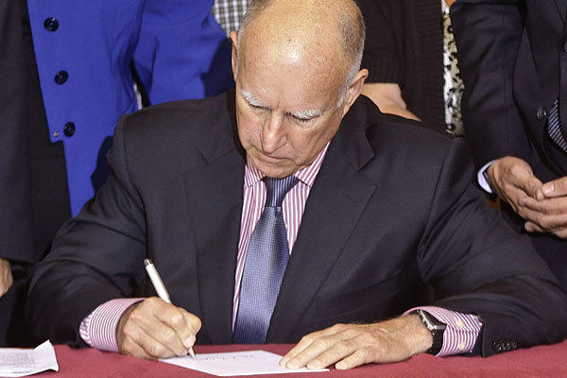
Overview of 2016
Legislative Activity
1,059 bills sent to Governor Brown
Governor signed (or allowed to become law without signature) 900 bills
Governor vetoed 159 bills
11 bills impacting CalBRE

Slide 25

AB 2330 (Ridley-Thomas)
Goes into effect on January 1, 2018.
Two main program changes:
  Petition process for removal of discipline from CalBRE’s website.
  CalBRE tracking of Broker Associates

Slide 26
AB 2330 (Ridley-Thomas)
Existing law requires CalBRE to post status of every license on its website;
    Including all discipline.
Legislation authorizes the Commissioner to set up a petition process to remove license discipline from website.

Slide 27

AB 2330:
Petition Process
Requirements:
  Licensees only – not unlicensed or formerly licensed;
  May petition 10 years after discipline imposed ;
  Fee and Petition Form to be established by regulation;
  “licensee provides evidence of rehabilitation indicating that the (website) notice is no longer required in order to prevent a credible risk to the members of the public”.

Slide 28
AB 2330
Regulations under development now.
Goal: One petition form, one price, one investigation

Slide 29
AB 2330:
Broker Associate Tracking
    Existing law requires CalBRE to post status of every license on its website:
      Including identifying salespersons affiliated with a broker.
  Legislation will require responsible brokers to notify CalBRE regarding brokers associated with and acting as salespersons for them;
Regulations under development;
Forms are being created;

Slide 30
AB 2330:
Broker Associate Tracking
“Broker Associate” is defined to be a broker who is under contract to work as a salesperson for another broker;
HOWEVER: A broker is not statutorily limited to working for just one broker.

Slide 31
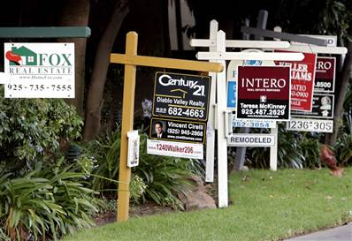
AB 1650 (Frazer):
License ID Disclosure
Revisiting the “First Point of Contact Solicitations”
Regulations under development
License ID now required for print and electronic media ads, certain “for sale” sign uses, and classified rental ads

Slide 32

SB 1196 (Hill):
Guilty Plea
B&P §10177(b)(2) added
Goal: Empower Real Estate Commissioner to suspend a licensee where he or she enters guilty plea in federal case, but sentencing will be delayed
Intended for very limited use

Slide 33
SB 710 (Galgiani):
Team Names
  Existing law permits use of team names provided:
    The name is used by two or more real estate licensees;
    The licensees represent themselves to the public as being part of a team, group or association;
    The name includes the surname of at least one of the licensee members of the team, group or association;

Slide 34
SB 710 (Continued)
    The name does not include or suggest real estate broker, real estate brokerage, broker or brokerage;
    Identifies the responsible broker
  Legislation revises the definition of responsible broker to mean broker’s name or broker’s name and CalBRE license number.

Slide 35
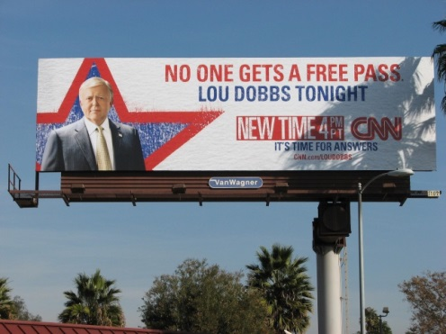
AB 1381 (Weber):
Exemption from Real Estate Law for Outdoor Advertisers
Existing law requires broker’s license for buying/selling or leasing/renting of real property for another in expectation of compensation;
Legislation exempts certain outdoor advertising representatives;
New Section: 10133.45

Slide 36
AB 1381 (Continued)
Outdoor advertising representative defined as:
    An employee of a corporation, LLC, or partnership;
    The employer holds a CalTrans license to engage in the business of outdoor advertising;
    The employee arranges for the lease/transfer of real property for his or her employer;
    The real estate transaction is solely for the placement of, access to, or operation of an advertising display;
    Specified liability insurance in place

Slide 37

AB 685 (Irwin):
Real Estate Law “Clean-up”
“Salesman” – Gone!
Nothing substantive, but many sections with small changes you may spot.

Slide 38
AB 73 (Waldron):
Removing Required Disclosure of HIV/AIDS Situations
Went into effect on September 24, 2016;
Relates to prior Civil Code requirements of disclosure about prior occupant’s HIV-positive status or death from AIDS-related complications

Slide 39
SB 1150 (Leno):
Mortgage Successors in Interest Assuming Deceased’s Mortgage
Prevents a mortgage servicer from foreclosing where:
  Original borrower died;
  Borrower’s “successor in interest” documents to servicer his/her status, and interest in assuming the loan or some foreclosure alternative loan.

Slide 40
CalBRE – Legal Affairs
Court Decisions

Slide 41
Horiike v. Coldwell Banker
California Supreme Court, Case No. S218734
Decided November 21, 2016;
Case addresses residential dual agency and scope/extent of agent’s fiduciary duty;
Representation
  Buyer’s agent was salesperson Chizuko Namba;
  Seller’s agent was salesperson Chris Cortazzo;
  Both agents were employed by Coldwell Banker, but served on different teams and worked out of different offices.

Slide 42
Horiike v. Coldwell Banker
California Supreme Court, Case No. S218734
Mr. Horiike thought he was buying a 15,000 square foot house in Malibu only to find out that the living space totaled approximately 9,434 square feet;
Seller’s agent never reported discrepancy;
Crux of dispute is whether seller’s agent had a duty to Mr. Horiike (the buyer) to report discrepancy;

Slide 43
Horiike v. Coldwell Banker
California Supreme Court, Case No. S218734
Coldwell Banker argued no duty because separate agents on separate teams from separate offices;
Mr. Horiike argued Coldwell Banker by definition was a dual agent and its duty as broker carried over to its salespersons;
Supreme Court held seller’s agent owed a fiduciary duty to the buyer.

Slide 44


Audits
Daniel Sandri
Chief Deputy Commissioner

Slide 45
Shortage Findings of Audits Completed
 | 1/1 – 12/31 2015 | 1/1 – 12/31 2016
Total Audits Completed | 607 | 585
Total $ Shortage | $13.87 million | $8.46 million
% Audits with Shortage | 36.2% | 32.5%
#(%) with $10K+ Shortage | 77 (12.7) | 67 (11.5)

Slide 46

What Audits is Seeing
We continue to find:
Trust Fund Shortages on PM, BE audits
42% of PM audits
44% of BE audits
Lack of Broker oversight
Advance Fee Violations
Falsification of bank records

Slide 47
What Audits is Doing
Investigative Audits
Property Management and Broker Escrow Audits
Follow-up Audits Pursuant to Legal Case
Restricted Licensee Audits – Results from 45 Completed:
  Trust Fund Shortages: 20
  No Violations: 10

Slide 48

Broker Escrow Notification
Per §10141.6, Brokers required to report if engage in 5 or more, or activities ≥ $1 million.
For Calendar 2015, 170 Brokers Reporting
Dollar amount reported…?
$10.3 BILLION!

Slide 49
Top Broker Escrow Violations
Trust Fund Handling – §10145/Reg. 2832
Trust Fund Recordkeeping – Regs. 2951, 2831, 2831.1, 2831.2 et seq
Fictitious Business Name - §10159.5/Reg. 2731
Failure to Supervise - §10159.2/Reg. 2725
Trust Fund Shortage – §10145/Reg. 2832.1
Failure to Disclose Interest – Reg. 2950(h)
Failure to Maintain Records - §10148/Reg. 2950 (d,e)

Slide 50
Q&A
THANK YOU
This power point presentation will be made available in its entirety on the CalBRE website.
www.bre.ca.gov
Next Meeting to be held in
Sacramento, CA – May 5, 2017

