Slide 1
Department of Real Estate
2009 Bay Area Multi-Cultural Real Estate Summit

Slide 2
Ethnicity of Buyers
SOURCE: California Association of REALTORS®

Slide 3
Ethnicity of Buyers
SOURCE: California Association of REALTORS®

Slide 4
Age of Buyers
SOURCE: California Association of REALTORS®

Slide 5
Median Age of Buyers
SOURCE: California Association of REALTORS®

Slide 6
Ethnicity of Sellers
SOURCE: California Association of REALTORS®

Slide 7
Age of Sellers
Sellers Median Age: 37
SOURCE: California Association of REALTORS®

Slide 8
Median Age of Sellers
SOURCE: California Association of REALTORS®

Slide 9
Member Profile Survey
Ethnicity of Members
SOURCE: California Association of REALTORS®

Slide 10
Department of Real Estate
Combating Mortgage Fraud

Slide 11

Department of Real Estate
Providing Service, Protecting You
Issues real estate broker and salesperson licenses
Approves subdivision public reports
Investigates consumer complaints
Takes administrative action against a licensee
Issues D&Rs to non-licensees

Slide 12
Department of Real Estate
Providing Service, Protecting You
Has the authority to revoke or suspend a license for violations of the Real Estate Law
Does not have authority to prosecute criminal or civil matters - referred to the Attorney General’s Office for prosecution.

Slide 13

Foreclosure Rescue Fraud
Scams misleading homeowners to transfer of the grant deed and/or up-front fees
Scammer profits by remortgaging the property or pocketing fees paid by the homeowner
No help to the homeowner
in trouble

Slide 14



Loan Modification
Fraud
Guarantee success due to expertise, affiliations or knowledge of government programs.
Advertise through the radio, television, printed promotion and internet marketing to attract desperate homeowners – many of whom may have been turned down elsewhere and cannot qualify
Perform no services – obtain no results

Slide 16
2007 = 239,179
2008 = 383,014
2009 YTD = 299,163

Slide 17
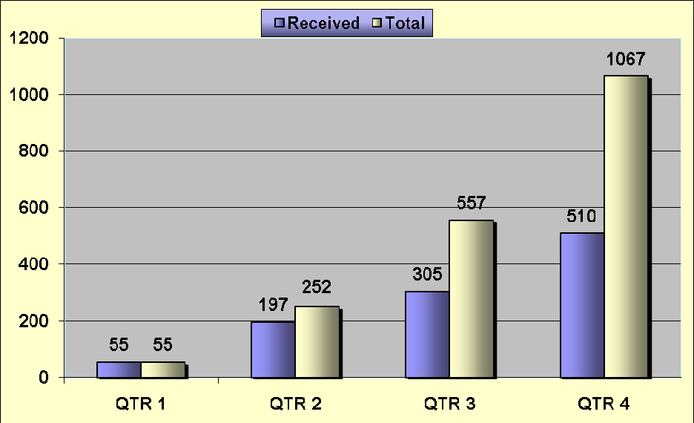
Loan Modification
Complaints
Fiscal Year 08-09

Slide 18
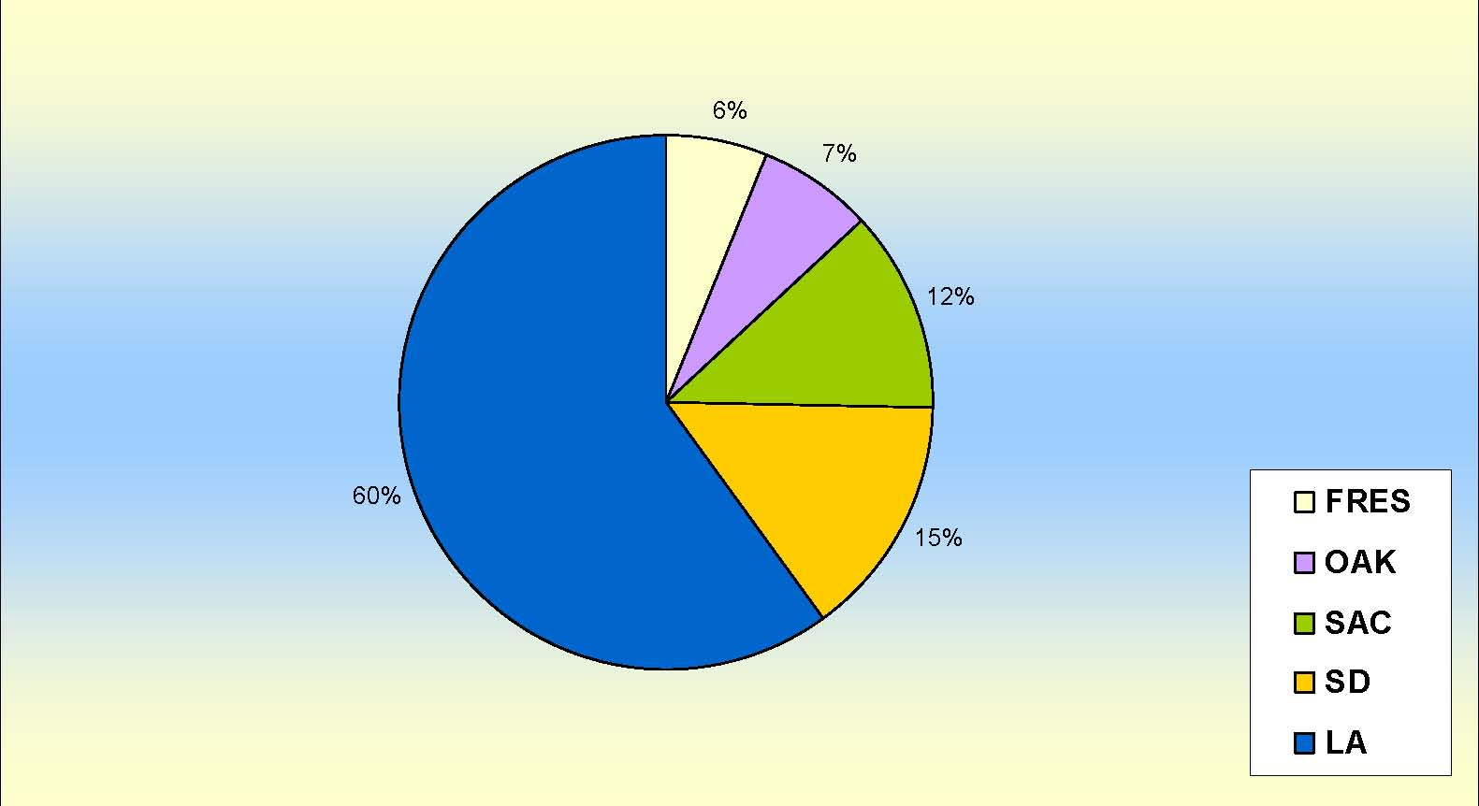
Loan Modification Complaints
By DRE Office/Region
Fiscal Year 08-09

Slide 19
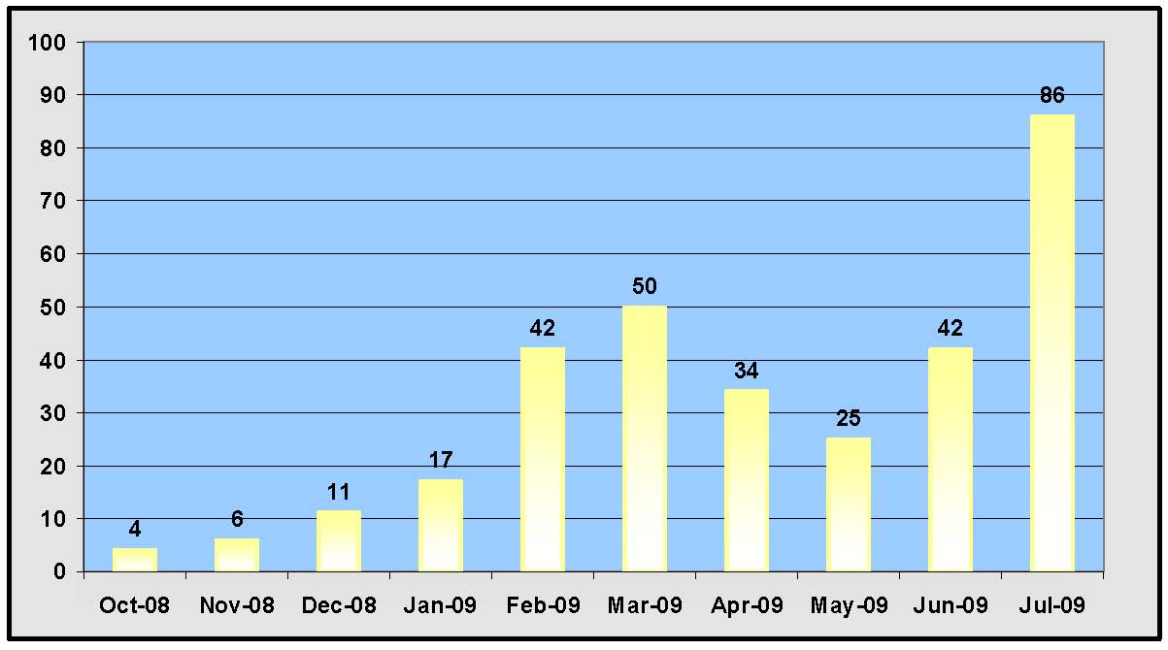
Loan Modification
DRE Actions Filed

Slide 20

Remedies Underway
Consumer Awareness
    and Education
Oversee Licensed Activities
Cooperative Enforcement Efforts
Criminal and Civil Prosecution
Industry and Business Support

Slide 21
Department of Real Estate
Providing Service, Protecting You

Slide 22
Department of Real Estate
Providing Service, Protecting You
“Log on,
Look ‘em up and
Check ‘em out!”

